Slide 1
Verification
Spring 2022
Tufts University
Instructors: Joel Grodstein, Scott Taylor
Generating stimulus

Slide 2
Outline of this lecture
Random & directed – the basics
FPU case study
CPU case study
Fancy stuff: machine learning
Error injection

Slide 3
Generating test content
Word association game
More the better ☺
So – how do you generate stimulus, and lots of it?
Aside: we know now there’s more to verification than generating stimulus, right?
Review – but what exactly?
Well: monitors, checkers, coverage measures, …
good verification
write lots of tests

Slide 4
Directed vs. random
Directed
you decide exactly what test to write
you (a human) write it
Random
not quite fully-random input!
you write a “template”
template + randomization = lots of tests
Pros & cons? Quality vs. quantity?
Sometimes, to some extent, yes ☺
Cost is not the only issue with directed testing

Slide 5
Writing a test is hard!
(good)
Humans are lousy at thinking of corner cases
so we never know what test to write
Control from the pins is hard
yet again (we’ve seen this issue multiple times)
we may know what to test deep in the machine
it’s hard to make that happen from the inputs
outputs
inputs
stuff
other
stuff
my stuff
Notes:
We try to think of the corner cases that the designer missed – but if they were easy to think of, the designer would have thought of them too!

Slide 6
Does randomness work?
Does it seem weird that random tests can do better than a human at making something happen deep inside?
maybe it’s not as efficient
there’s a lot to be said for letting a machine crank stuff out while you relax on the beach ☺
outputs
inputs
stuff
other
stuff
my stuff

Slide 7
Mesh in a system
30
31
32
33
Start with the mesh
Declutter the drawing
but really the routing links are still there!
20
21
22
23
10
11
12
13
00
01
02
03

Slide 8
Ca
Pr
MC
Gr
30
31
32
33
Add the mesh drivers and receivers
Pr=processor
Ca=cache
MC=memory controller
Gr=graphics
DD=disk drive controller
Pr & Ca might be combined
Ca
Pr
MC
Gr
20
21
22
23
Ca
Pr
IO
DD
10
11
12
13
Ca
Pr
IO
DD
00
01
02
03

Slide 9
Bug
Ca
Pr
MC
Gr
30
31
32
33
When Pr₁, Pr₂, MC₁ all interact with Ca₁:
Pr₁ wr-requests L
Ca₁ evicts L, Pr₂ rd-req L
MC₁ fills any line
This exposes Ca₁ bug ☹
Ca
Pr
MC
Gr
20
21
22
23
Ca
Pr
IO
DD
10
11
12
13
Ca
Pr
IO
DD
00
01
02
03

Slide 10
Way too many cross products!
Ca
Pr
MC
Gr
30
31
32
33
Cannot test all interactions between 4 entities!
You can test a random subset
Again: no guarantees, but it’s about the best you can do
Ca
Pr
MC
Gr
20
21
22
23
Ca
Pr
IO
DD
10
11
12
13
Ca
Pr
IO
DD
00
01
02
03

Slide 11
Outline of this lecture
Random & directed – the basics
FPU case study
CPU case study
Fancy stuff: machine learning
Error injection

Slide 12
What’s in a float?
IEEE 754 has various classes of numbers
zero, infinity, NaN
denormals
everything else!
Rules of the new math
2x2 =
1 / 0 =
∞ + ∞ =
-1 / 0 =
∞ - ∞ =
0 / 0 = ∞/∞ =
4
∞
That’s everything except
-0 vs. +0
denormals
∞
-∞
NaN
NaN
Notes:
Negative and positive zero is because we use sign+magnitude rather than 2s complement
Denormals are a special case for very small numbers (more later).

Slide 13
Number line
Here’s the number line (sort of)
NaN -∞
-0 +0
+∞ NaN
everything else
everything else
denormals
Notes:
Note that there is no “negative” vs. “positive” NaN; the spec says that the sign bit is ignored for NaN

Slide 14
What should we test?
The special cases are a small fraction of total area
which parts are most important?
what should our strategy be?
Where do you think the bugs are?
the “weird” stuff; denorms, infinity, etc?
Or not – maybe the designer spent the most time on that!
NaN -∞
-D -0 +0 +D
+∞ NaN
Notes:
Mention in passing that 2^32 choices for each operand is too many to test exhaustively (there will be a quiz question later on the details).

Slide 15
More corner cases
FPUs have well-known critical paths
designers do headstands to make their FPU run fast
do those headstands cause their own corner cases?
How might you (the verif. engineer) even know what headstands were done?
ask the architect

Slide 16
Trust or verify?
Perhaps the architect says:
I love that denormal stuff; all those special cases were really interesting & I know I got it right
I hate infinity, honestly I just wrote some junk to make my coding deadlines & it’s probably buggy
I’m pretty sure I got most of the rest right
So what content strategy do you use?
Write lots of manual tests for ∞, none for denorms, a few for the rest, and you’re done?
Question: how much do you believe your favorite architect?

Slide 17
Trust or verify?
How many tests did you believe you:
would ace and didn’t?
would fail and didn’t?
By and large, your guesses about preparedness were probably mostly correct
but would you bet project success on it?

Slide 18
Trust or verify?
Wisdom though the ages
“The known unknowns are are things that we know we don’t know. But there are also unknown unknowns. There are things we don’t know we don’t know.” Donald Rumsfeld, 2002
“It’s the issues you didn’t predict that get you. You never know just what you don’t know until it’s too late.” Nobody in particular
But how do you translate this wisdom into resource allocation for FPU test content?

Slide 19
Purely random?
Pick purely random operands, operations?
Would that work well?
Rarely hits corner cases
2³² choices for each operand
odds of picking 0, ∞, NaN are very low
odds of fleshing out corner cases of these values with a purely random approach are vanishingly low ☹
Any better ideas?
NaN -∞
-D -0 +0 +D
+∞ NaN

Slide 20
Knobs & weights
Pick operand
denorm_frac odds of being a denorm
special_frac odds of being NaN, ∞, 0
else a “normal” float
then pick exact operand randomly
Pick operation
add_frac, divide_frac, etc.
These controls are called knobs or weights
give you high-level control of your randomness
tailor them to your needs
First pick class
Then pick value

Slide 21
In-class exercise
Perhaps the architect says:
I love that denormal stuff; all those special cases were really interesting & I know I got it right
I hate infinity, honestly I just wrote some junk to make my coding deadlines & it’s probably buggy
I’m pretty sure I got most of the rest right
Pick operand
denorm_frac odds of being a denorm
special_frac odds of being NaN, ∞, 0
else a “normal” float
then pick exact operand randomly
Pick operation:
add_frac, divide_frac, etc.
How will you set the knobs?
Notes:
Let them figure this out now. Probably roughly follow what the architect said, but with lots of deference to your own feelings, and past experience with previous FPUs.

Slide 22
Outline of this lecture
Random & directed – the basics
FPU case study
CPU case study
Fancy stuff: machine learning
Error injection

Slide 23
CPU testing
Designing an RCG for our simple FPU was easy ☺
But a CPU is bigger & more complex ☹
Can we do something similar?
What was the hardest part of EE126 design?
Pipeline stalls?
Forwarding?
Getting branches right?
Can we design a CPU RCG that generates tests roughly targeted at the buggy areas?
a.k.a. “most likely to have bugs!”
Notes:
and by “hardest”, I mean “most likely to have bugs!” Especially in the pipelined version

Slide 24
RCG
Can we build a Random-Code Generator (RCG)?
Start with a completely random sequence of instructions – any issues?
arithmetic:
branches:
memory:
So completely random testing isn’t great. Next idea?
what about divide by zero?
what about infinite loops? And how do we know if the test passed?
load before store → unpredictable results
Notes:
Little historical note – RCG is literally random code – but the term RCG is now used for most any random test driver.
The “how do we know if the test passed” issue for branches is that merely taking a branch doesn’t change any architectural register, so we may not be able to figure out after the fact which branch was taken.

Slide 25
Exercise: can you fix the issues?
Start with a completely random sequence of instructions – any issues?
arithmetic:
branches:
memory:
what about divide by zero?
what about infinite loops? And how do we know if the test passed?
load before store → unpredictable results
Can you slightly modify the random code sequences to avoid these problems?

Slide 26
Exercise: can you fix the issues?
Arithmetic: can do random ops, and then…
throw away the divide-by-zero and similar tests
They should be a small fraction of all tests
Branches
analyze the random programs, remove infinite loops?
and put different loads after each branch path?
Memory
Do loads in store+load pairs
Move them randomly but always put the store first
Are the fixes starting to sound a bit algorithmic rather than random?
Yes! We call that a template
Notes:
Note that these suggestions are going away from our totally-random approach. In particular, the memory one seems more algorithmic than random, and the “loads after branches” seems a bit algorithmic also.

Slide 27
Templates
We really want our same FPU strategy
target buggy areas
in proportion to expected bugginess
But a single instruction won’t do a useful test
need a coherent group of instructions working together
A template
gives your test a structure, order, global logical sense
Then knobs
control the details of what to randomize
and within what constraints

Slide 28
Knobs & weights
Pick operand
denorm_frac odds of being a denorm
special_frac odds of being NaN, ∞, 0
else a “normal” float
then pick exact operand randomly
Pick operation
add_frac, divide_frac, etc.
These controls are called knobs or weights
First pick class
Then pick value
Would you still call these knobs, or are they really templates?
What might a template be for the FPU?
Notes:
A template for the FPU might control a bigger sequence; maybe you always wrap three FPU ops between a load & store for some reason, and also run a power virus.

Slide 29
St/ld template
We had reordered st/ld pairs; here’s another template
Pick N₁ random addresses
Store random values → all of them
Repeat N₂ times:
pick one of the known addresses
Ld → random register
Store a random known register → random address
How might we check results?
now there are more known registers
now there are more known addresses
Notes:
Remember that we are randomizing stuff in our stimulus generator (which is part of the TB).
The point is that the TB knows what we wrote, so it can finish up by checking that memory and registers are all correct.
This isn’t perfect – we may write a single location multiple times, & we only check the final value. More on that shortly!

Slide 30
2-way set-associative cache
way #0 way #1
@0
T
@1000
T
set #0
@201
T
@1
T
set #1
@402
T
@202
T
Refresher from EE126 ☺
How do you pick Ld/St addresses to stress L1 misses?
sets
@7FE
T
@3FE
T
@11FF
T
@1FF
T
=
=
[31:14]
[13:5]
[4:0]
<<
index
data
hit?
Notes:
You pick addresses that are in the same set. I.e., lots of addresses with the same addr[13:5] but different addr[31:14].

Slide 31
Knobs
same cache line or set
Pick N₁ random addresses
Store random values → all of them
Repeat N₂ times:
pick one of the known addresses
Ld → random register
Store a random known register → random address
fraction to existing vs. new addr?
What knobs might control this template (given our L1 knowledge)?
How might you enhance it?
Notes:
Same cache line or block is interesting. We can control L1 hits vs. misses via same cache line. We can control L1 evictions and L2 usage by using lots of addresses in the same set.
The “fraction to existing vs. new addr” is the same idea.
The “store with random values” is probably not really relevant in this test.

Slide 32
Constraints – details
How do you pick lots of addresses with
the same value for addr[13:5]
different values for addr[31:14]
addr_13_5 = $urandom_range (9'h1FF);
for (int i=0; i<10; ++i) begin
addr_31_14 = $urandom_range (18'h3FFFF);
addr = { addr_31_14, addr_13_5, 5'h0 };
end
SystemVerilog has an extensive facility for constrained randomization
Spear chapter 6
https://www.systemverilog.io/randomization
Notes:
Strictly speaking, this code snippet just overwrites the same variable addr. But you get the idea ☺

Slide 33
Discussion
Mesh lab #2 asks you to build an RCG to drive the mesh
How could it work?
What knobs will be useful for your mesh RCG?

Slide 34
Outline of this lecture
Random & directed – the basics
FPU case study
CPU case study
Fancy stuff: machine learning
Error injection

Slide 35
Knobs & weights
Remember this slide?
Pick operand
denorm_frac odds of being a denorm
special_frac odds of being NaN, ∞, 0
else a “normal” float
then pick exact operand randomly
Pick operation:
add_frac, divide_frac, etc.
These controls are called knobs or weights
give you high-level control of your randomness
tailor them to your needs
Exercise – how will you set the knobs?
what the architect said + your own experience
How much do we trust anyone’s intuition?
Can we do better?
Notes:
We said we would set the knobs based of a combination of where the architect thought the bugs are, plus our own intuition and past experience. But really, all of that is just guesses. What if we don’t trust anyone’s predictions, including our own?

Slide 36
Genetic algorithms
When you have no idea, try machine learning ☺
Mate and mutate knob settings
denorm_frac | .3
special_frac | .2
add_frac | .4
mpy_frac | .2
.3
denorm_frac | .5
special_frac | .3
add_frac | .3
mpy_frac | .6
.3
.3
.2
mating
mutation
denorm_frac
special_frac
add_frac
mpy_frac
denorm_frac | .5
special_frac
add_frac | .3
mpy_frac
.4
.3
.5
.6

Slide 37
Genetic algorithms
Start with 10 different knob combinations
Run 100 tests with each; which finds the most bugs?
Keep the 2 best knob combos
Try some mutations of those 2 best
Add some matings between those & others, etc
Automatically play with knobs, see what works
What key assumption might make this work?
there are some patterns; the bugs you’ve found can predict the ones you haven’t
past performance predicts future results

Slide 38
Reasonable?
Key assumption:
the bugs you’ve found can predict the ones you haven’t
past performance predicts future results
But do you think the assumption is reasonable?
Notes:
If the knob is load/store vs. arithmetic, and in fact the guy who designed the ld/store unit is incompetent, then yes – it’s quite reasonable.
If we’ve trying to find the right knob to work through 10 queues and hit bad cache timing, then probably not.

Slide 39
Genetic alg + coverage
Our metric: success = most bugs found
Another metric for a GA: most coverage
will revisit after we discuss coverage

Slide 40
Many Rats
Once you find a bug, what do you do?
pat yourself on the back ☺
fix it
launch a Many Rats task force
Many rats
what does this bug say about design methodology?
About people?
Intuition – trying to decide if past performance does predict future results
and if so, is there a good way to explore this area of the design more thoroughly?
“an island of directed in a sea of random”
Notes:
If you’ve found one rat in your kitchen, there are probably more!
“An island of directed in a sea of random” is a quote from Jim Huggins. It means that you have a ton of random content that finds problematic areas, and then a set of directed tests that explore those areas more fully.

Slide 41
Outline of this lecture
Random & directed – the basics
FPU case study
CPU case study
Fancy stuff: machine learning
Error injection

Slide 42
Divide by zero
Arithmetic: can do random ops, and then…
throw away the /0 and similar tests
They should be a small fraction of all tests
Remember this?
We’ve tried not to do things like /0
how good is that strategy?
probably not very!
Actual programmers divide by 0 all the time
CPU architecture specifies exception-handling rules
it’s probably a corner case!
we must test this too!
How? the usual strategies…
first set up all the exception vectors so you know what happened
one directed /0 test?
RCG combining multiple exceptions in the same cycle?

Slide 43
Broken mesh links
30
31
32
33
Remember what the mesh looks like? ☺
Let’s talk about broken links
20
21
22
23
10
11
12
13
00
01
02
03

Slide 44
Broken mesh links
Why do we care about broken links?
Hopefully this is pretty obvious!
All links will eventually fail
Big question – then what?
Does the network fail? Get slower? How much slower?
Is resilience a big selling point for networks?
How might you compare its importance to bandwidth, latency?
99.999% uptime
Notes:
And anytime we have an important feature – we have to verify it!

Slide 45
Verifying resilience
What do we have to verify?
One broken link? Two? More? Why?
Any ideas how we might verify resilience?
Do we have a separate model with a broken link?
Separate models for all combinations of two broken? Three?
Better solution: the verification environment clobbers links
Do we do this randomly or directed?
Lookahead – mesh-challenge lab is exactly this
Notes:
If one broken link is rare, do we need to model two or more broken links? Depends on the cause. A snowstorm could cause lots of downed lines. Ditto for an electrical failure in a neighborhood. Perhaps less likely to have two broken links in one chip – but perhaps a wafer at an unusual process corner.

Slide 46
Error injection
Any other “errors” to test for?
i.e., an unusual event with a specific response
Single-bit memory errors, noise in packet transmission, broken links, …
These are typically bug farms!
All of this needs to be tested
often lots of special-purpose directed tests

Slide 47
CrashMe
CrashMe
RCG from U. Michigan, 1990s
Literally wrote random bits and called it code!
What do you think the results were? Useful?
Notes:
Actually, it was amazingly effective at crashing operating systems ☺.
One user running CrashMe could take down the O/S or at least crash other users also.
Neither the CPU designers nor the O/S writers had ever expected to see truly random bits!
I (Joel) wonder if this is a bit of an urban legend – you would think that trying to execute a data file would be fairly commonplace.

Slide 48
BACKUP

Slide 49
For next year
Add Scott’s many-rats example:
an IP vendor updated the spec of their IP without really warning Nvidia. This caused a bug. Then the many-rats was to look through all the other IP vendors’ docs and see if there were any updates.

Slide 50
Floating-point math unit
IEEE 754 standard:
Start with mantissa and exponent
25 = 2.5 x 10¹
512 = 5.12 x 10²
.15 = 1.5 x 10⁻¹
But it’s really in binary, not decimal!
3 = 0b11 = 1.1 x 2¹
11 = 0b1011 = 1.011 x 2³
.75 = 0b .11 = 1.1 x 2⁻¹
1.0 ≤ mantissa < 10
1.0 ≤ mantissa < 2

Slide 51
Now make it sneaky
Our numbers, again
3 = 0b11 = 1.1 x 2¹
11 = 0b1011 = 1.011 x 2³
.75 = 0b .11 = 1.1 x 2⁻¹
The first mantissa bit is always “1”
So don’t bother storing it!
Called a “hidden bit”
1.0 ≤ mantissa < 10
31 30 23 22 15 7 0
sgn exp mantissa

Slide 52
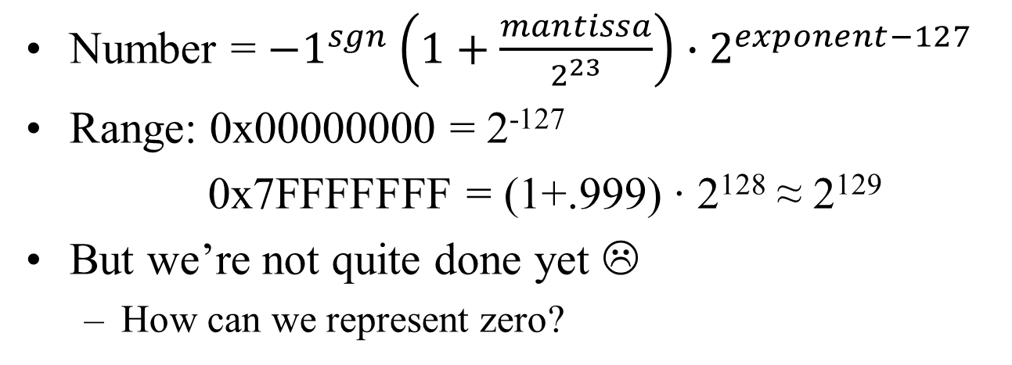
IEEE 754 summary
Number = ${−1}^{sgn}\left(1+\frac{mantissa}{2^{23}}\right)∙2^{exponent−127}$
Range: 0x00000000 = 2⁻¹²⁷
0x7FFFFFFF = (1+.999) ∙ 2¹²⁸ ≈ 2¹²⁹
But we’re not quite done yet ☹
How can we represent zero?
31 30 23 22 15 7 0
sgn exp mantissa

Slide 53
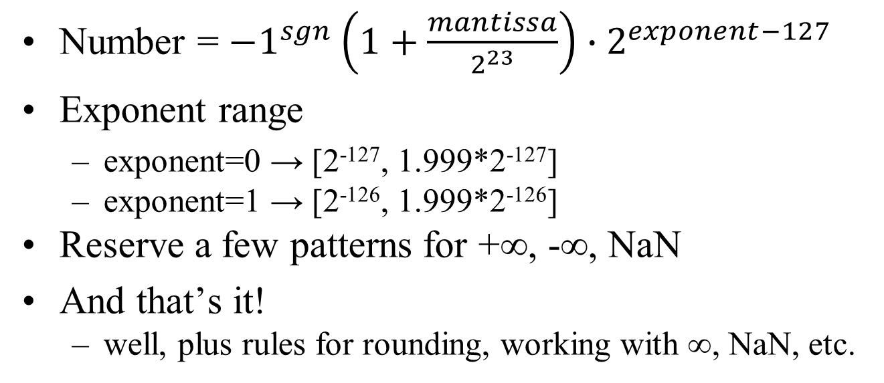
Denorms and special numbers
Number = ${−1}^{sgn}\left(1+\frac{mantissa}{2^{23}}\right)∙2^{exponent−127}$
Exponent range
exponent=0 → [2⁻¹²⁷, 1.999*2⁻¹²⁷]
exponent=1 → [2⁻¹²⁶, 1.999*2⁻¹²⁶]
Reserve a few patterns for +∞, -∞, NaN
And that’s it!
well, plus rules for rounding, working with ∞, NaN, etc.
[0, 1.999*2⁻¹²⁷]
31 30 23 22 15 7 0
sgn exp mantissa
Notes:
When you cover [0,1.999*2^(0127)] in the same 23 bits of mantissa, the spacing between the numbers gets bigger; and that’s before reserving the special patterns.
Exponent=0x00 is denorms; (-1)^sign * mantissa/2^23 * 2^-126.
Exponent=0xFF is special. Mantissa=0 is infinity; mantissa not 0 is all NaN.

